Slide 1

Überblick Microsoft Cloud Adoption Framework
Adopt

Slide 2
Plan
An iterative process that supports your business … as it evolves
Govern
Manage
Define strategy
Adopt
Ready

Slide 3
Adopt - Migrate

Slide 4
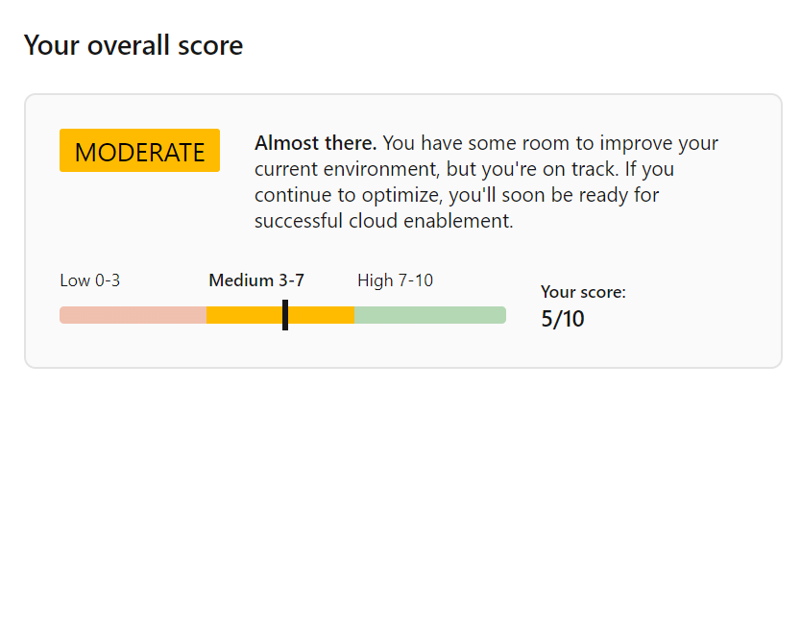
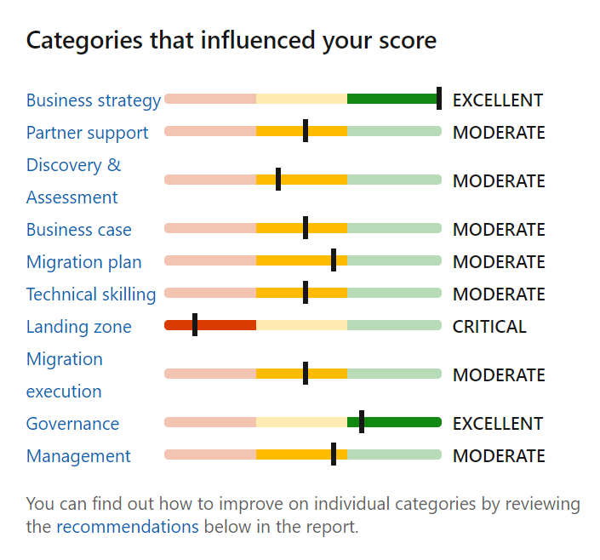
Assess your migration readiness
Use the Strategy Migration Assessment and Readiness tool across 10 readiness areas: aka.ms/smarttool

Slide 5
Migration: pre-requisite steps
Before proceeding with migration execution, it is required that all the upstream steps of Strategy, Plan and Ready are completed. Key deliverable assets include – the Cloud Adoption Plan template and a landing zone configuration.
Migration waves
Define strategy
Define business justification and expected outcomes
Plan
Align actionable cloud adoption plan to business outcomes
Ready
Prepare people, process and environment for change
Adopt
Migrate or Innovate
Implement desired changes across IT and business processes
Govern
Comply, control and secure
Manage
Operate and optimize
Assess migration readiness: https://aka.ms/smarttool

Slide 6




Adopt migration execution
Migrate
Migration waves (releases)
Plan, Ready, and Adopt establish repeatable processes for iterative change management and digital transformation. Those processes establish waves of workload migrations (releases in agile terms).
Plan
Ready
Adopt
Migration effort (iterations)
Assess workloads
Assess each batch of workloads to evaluate cost, architecture, and deployment tooling.
Deploy workloads
Replicate functionality in the cloud using IaaS, PaaS, cloud-native, or other modernization solutions.
Release workloads
Test, optimize, document, and review. Release by handing off for governance, management, and security.
Assess each workload and finalize architectural decisions about migration options.
Initiate the migration of the environment using native tools, third-party tools, and project management tools.
Workloads should be tested, optimized, documented, and released for ongoing operations.
Review the migrated workloads and hand them off to governance, operations management, and security teams for ongoing support of those workloads.
https://aka.ms/adopt/migrate

Slide 7



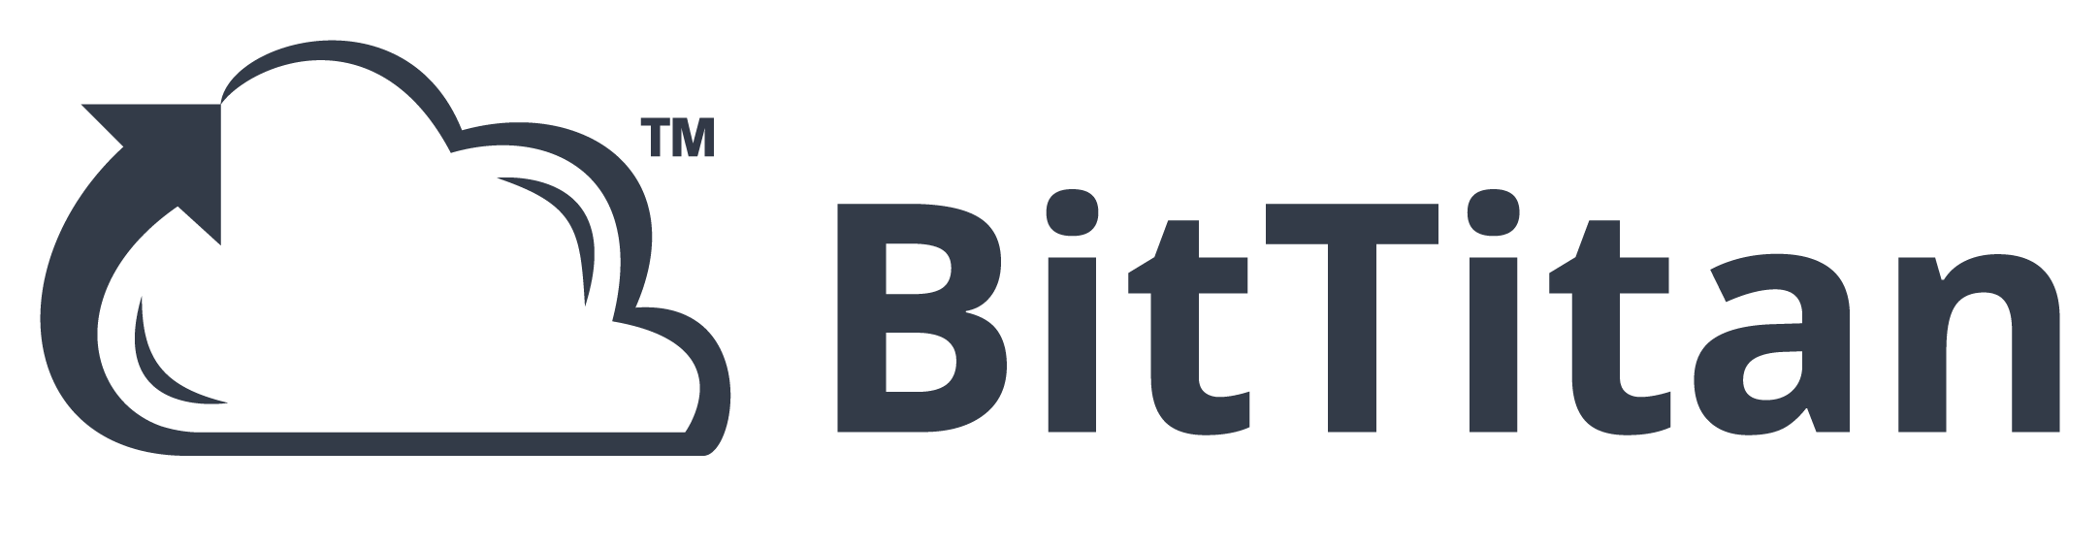










Migration tooling options
Assess workloads
Deploy workloads
Release workloads
Azure Migrate
Data Migration Assistant (DMA)
Azure Database Migration Service
Azure Cost Management
SQL Server Migration Assistant (SSMA)
Azure Data Box
Azure Advisor
Azure Monitor
Azure Security Center
ISV solutions (as needed)

Slide 8

Azure Migrate: a central hub for datacenter migration
Multiple scenarios
Migrate Windows and Linux Servers, Databases, Data, Web Applications and Virtual Desktops
Diverse capabilities
Comprehensive discovery, assessment, and migration capabilities powered by Azure and third-party tools
Centralized visibility
Centralized migration repository delivering end-to-end tracking and insights

Slide 9
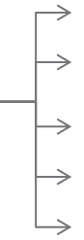

Best practice: setting up networking for migrated workloads
Implement a hub-and-spoke network topology
Design subnets
Set up a DNS server
Set up availability zones
Implement a highly available site to site VPN
Optimize ExpressRoute routing with BGP communities
Implement ExpressRoute for mission-critical connections
On-Premises
Spoke1
Spoke1
Spoke2
Spoke2
…
Internet
Internet
…
Spoke40
Hub
Hub
Spoke40
Spare Spoke
Spare Spoke
Spare Spoke
Internet
Spare Spoke
…
…
Hub
Spoke1
…
Spoke40
Spare Spoke
Spare Spoke
…

Slide 10

Best practice: cost-optimize migrated workloads
Before Migration
After Migration
Estimate monthly workload costs
Right size VMs
Select the right storage
Take advantage of Azure Hybrid benefits
Use reserved VM instances
Aggregate cloud spend across subscriptions
Use Azure Cost Management
Monitor resource utilization
Implement resource group budgets
Optimize Azure Monitor retention
Optimize storage
Automate VM optimization
Implement serverless technologies
Use Logic Apps and runbooks with Budgets API

Slide 11
Adopt - Innovate

Slide 12
Migration patterns | The five Rs of rationalization
What | Rehost | Refactor | Rearchitect | Rebuild | Replace
 | ls known as a lift and shift migration, a rehost effort moves a current state asset to the chosen cloud provider, with minimal change to overall architecture. | Refactoring code to enable an application to deliver on new business opportunities and fit a PaaS-based model. | Aging applications that aren't compatible with cloud providers might need to be rearchitected before transformation. Some applications might be more cost effective as cloud native solutions. | In some scenarios, the delta that must be overcome to carry an application forward can be too large to justify further investment. In this case, a new code base is created to align with a cloud-native approach. | Sometimes software as a service (SaaS) applications can provide all the necessary functionality for the hosted application.
Common drivers might include: | Reducing capital expense Freeing up datacenter space Achieving rapid return on investment in the cloud | Faster and shorter updates Code portability Greater cloud efficiency (resources, speed, cost, managed operations) | Application scale and agility Easier adoption of new cloud capabilities Mix of technology stacks | Accelerate innovation Build apps faster Reduce operational cost | Standardizing around industry-best practices Accelerating adoption of business process-driven approaches Reallocating development investments into applications that create competitive differentiation or advantages
Learn more: digital-estate/5-rs-of-rationalization

Slide 13

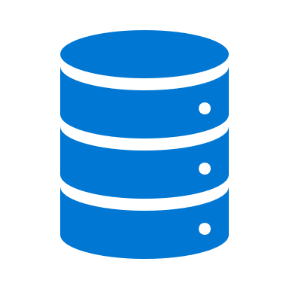



Migration tooling options
Assessment of an LOB Workload (N-tier App & Data)
Bandwidth Analysis
Storage: Data Box – Offline Transfer
Storage exceeds available bandwidth
Azure Storage
Re-hydrate from Azure Storage
Modernize App & Data
Yes
LOB App
Yes
App & Data: Refactor Pipeline/Re-Deploy
Refactor & Modernize
Expand workload architecture options with broad tooling options.
Dedicate VMs
Yes
Existing DevOps Pipeline
Azure App Service
App: App Service Migration Tool & Data: Azure Migrate – Database Migration
Migrate app and data to IaaS with no changes to the current state
No
Azure SQL (MI)
Hundreds of Apps per VM
LOB App
Innovation Potential
Migration is more than a lift and shift rehost to IaaS using tools like Azure Site Recovery.
Modernize some assets during migration with PaaS focused solutions like Database Migration Service.
Over time, refactor and modernize any workloads that represent innovation potential.
Yes
App & Data: Refactor Pipeline/Re-Deploy
Modernize Data Only
Yes
Existing DevOps Pipeline
Azure IaaS
App: Azure Migrate – Server Migration & Data: Azure Migrate – Database Migration
No
Azure SQL (MI)
Migrate app and data to IaaS with no changes to the current state
LOB App
Data Platform Analysis
Simple Data Platform
App: Azure Migrate – Server Migration & Data: Azure Migrate – Server Migration
Azure IaaS
Azure IaaS
Complex Data Platform: Cluster, High-Availability, Always On, etc.
LOB App
App: Azure Migrate – Server Migration & Data: Build New or Extend Hybrid Cluster – Synchronize data until promotion
Azure IaaS
Azure IaaS

Slide 14
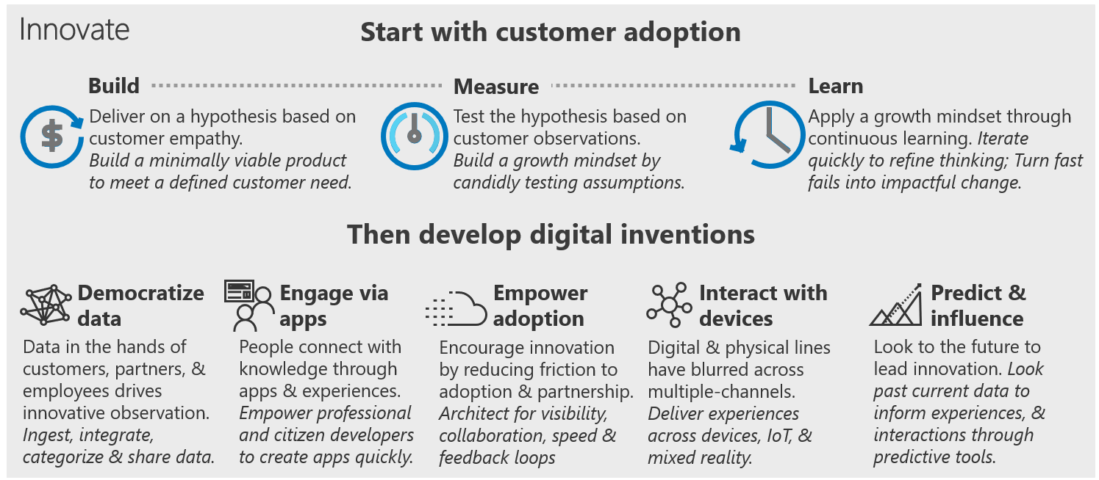
Adopt – Innovate Summary

Slide 15
Cloud Adoption Framework - Adopt
Cloud migration is the process of moving existing digital assets to a cloud platform. Adopt is divided into two different options, migrate and innovate.
Each cloud migration activity is contained during one of the following processes, as it relates to the migration backlog: assess, migrate, optimize, and secure. Then, you manage each backlog asset.
Modernization and innovation in the IT portfolio create tighter alignment with DevOps and accelerate innovations across the digital estate and application portfolio.

